Slide 1

CricPulse : The Ultimate Information Hub
Shuban Devenpelli – 22107023
Rishi Bije –22107002
Yash Kamble -22107055
Dhanraj Bacche - 22107056
Project Guide
Prof. Sarala Mary

Slide 2
Outline
Introduction
Literature Survey of the existing systems
Limitations of the existing systems
Problem statement
System Design
Technologies and methodologies
Implementation
Conclusion
References

Slide 3
Introduction
Cricpulse is a platform that provides various aspects of cricket.
Comprehensive Python-driven cricket platform to access, consume, and engage with cricket content seamlessly within a single application.
Empowering users to access player reports, explore field placements, and compare players effortlessly
Motivation :
By observing the fragmented nature of cricket-related features across various platforms, we were inspired to create a unified solution for users.
Addressing the shortcomings observed in existing Python cricket applications.

Slide 4
Objectives :
To facilitate the comparison of different sets of cricket-related data by retrieving data from database .
To create an user-friendly platform that provides cricket enthusiasts with easy access to comprehensive and up-to-date information by using Tkinter.
To provide insights into strategic field placements used by teams during cricket matches by retrieving images and data from database.
To provide individual player performances by retrieving data from database.

Slide 5
Literature Survey of the existing system
Sr No. | Title | Author | Year | Outcomes | Methodology | Result
1 | [1] Performance Analysis of a Cricketer by Data Visualization | Harshitha G, Sreehari G, Mahesh Kumar S , Chinmai L , Dr. Geetha D | 2022 | Data Visualization Of player performance | Collecting cricket performance data to create visualizations that reveal key trends and insights for evaluating a cricketer's performance. | Provides insights of Performance of the player.

Slide 6
Literature Survey of the existing system
Sr No. | Title | Author | Year | Outcomes | Methodology | Result
2 | [2] A review of cricket field requirements | D MacDonald, J Cronin, J Mills, M McGuigan, R Stretch | 2013 | Field set for specific bowling type is obtained | Reviewing cricket field requirements for bowlers, boundary lengths, field dimensions, and infrastructure to ensure optimal bowling performance and effective gameplay | This is information would also provide a framework for the design of felding-specific assessments, which should enable the development of more focused training, conditioning and coaching protocols.

Slide 7
Literature Survey of the existing system
Sr No. | Title | Author | Year | Outcomes | Methodology | Result
3 | [3] Context Based Cricket Player Evaluation Using Statistical Analysis | Vaibhav Khatavkar & Parag Kulkarni | 2019 | Analysis of player performance across different cricket series | Focusing on survival analysis techniques and the modeling approach used to capture player inclusion/exclusion patterns. | Provide insights on player performance using deep performance indexing

Slide 8
Limitations of existing systems
Lack of User-Friendliness
Outdated Technology
Lack of backend Database in Most Cricket-related Application
Data accuracy

Slide 9
Problem statement
In cricket all the necessary information needed is scattered and not up-to-date. There's no one place where everyone can go to get accurate and reliable data.
Existing platforms fail to integrate diverse cricket features seamlessly
Lack of free-to-use Tkinter Based User Friendly Application with comprehensive features

Slide 10
System Design
ADMIN
HOME
PLAYER PERFORMANCE
FIELD DETERMINATION
PLAYER COMPARISON
ADD/UPDATE/
DELETE DATA
COMPARE STATS

Slide 11
System Design
USER
HOME
PLAYER PERFORMANCE
FIELD DETERMINATION
PLAYER COMPARISON
VIEW ONLY
COMPARE STATS

Slide 12
Technologies and methodologies
Front-End:
Tkinter (version 8.6.14)
Customkinter (version 8.6.14)
Python (version 3.12.2)
Back-End:
MySQL (version 8.1.0)

Slide 13
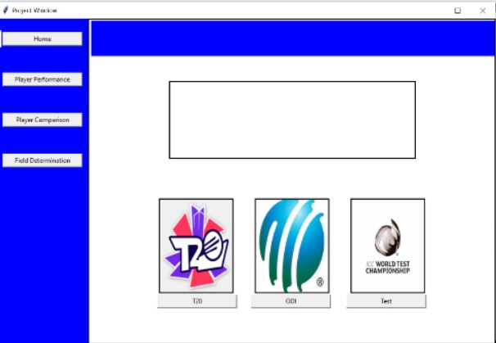
Implementation

Slide 14
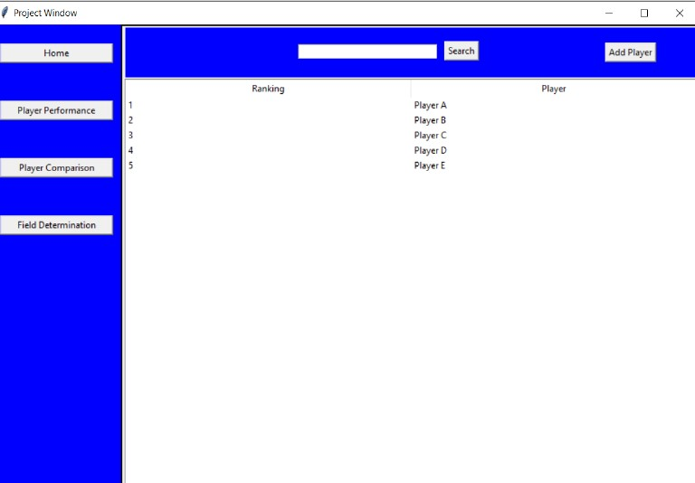
Implementation

Slide 15
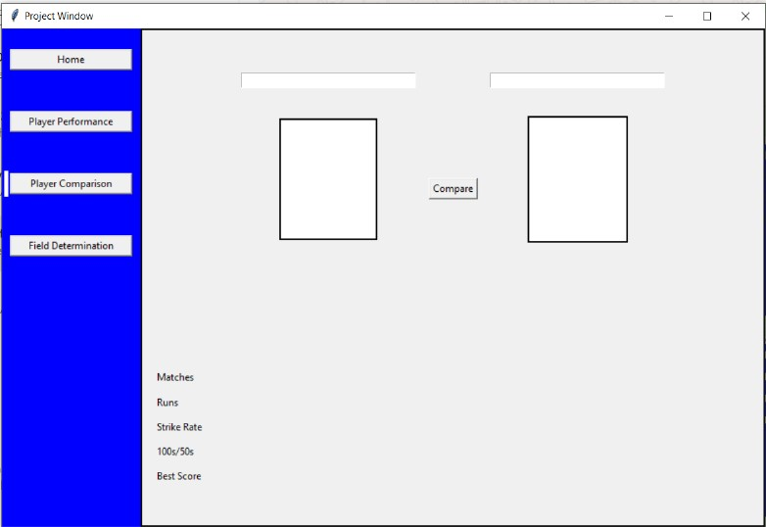
Implementation

Slide 16
References
[1] Harshitha G, Sreehari G, Mahesh Kumar S,Chinmai L, Dr.GeethaD
“Performance Analysis of a Cricketer by Data Visualization”, International journal for applied science and engineering technology,2022
[2] D MacDonald,J Cronin,J Mills,M McGuigan,R Stretch “A review of cricket field requirements”, Sport Performance Research Institute,2013
[3] Vaibhav Khatavkar & Parag Kulkarni , “Context Based Cricket Player Evaluation Using Statistical Analysis ”, International Journal of Knowledge Based Computer Systems ,2019

Slide 17
Conclusion
Hence, Devlopment and Implementation of 100% of Python Based Application providing seamless user experience.
Cricpulse is providing a comprehensive platform for user ,through it’s user-friendly interface.

Slide 18
Thank You...!!

